Slide 1
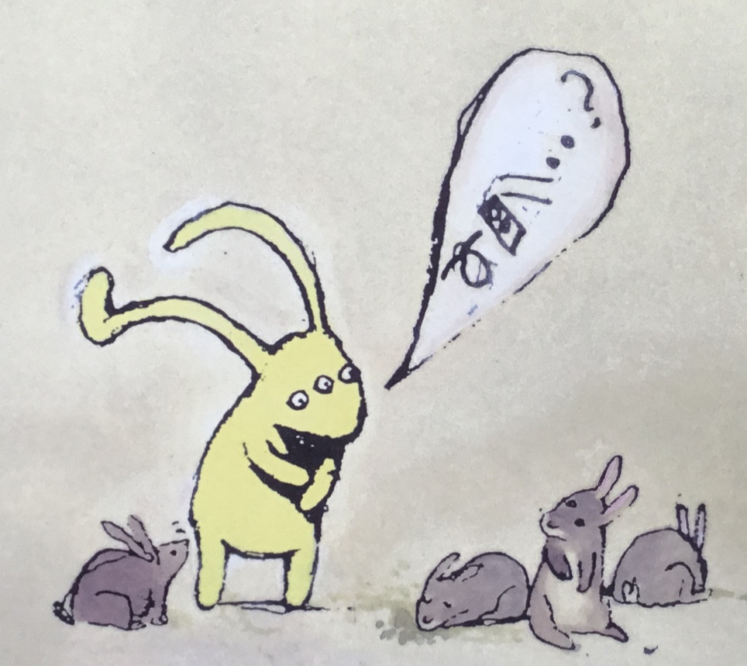
Infant Music Festivals 2024
Activities inspired by Beegu
a picture book by Alexis Deacon

Slide 2
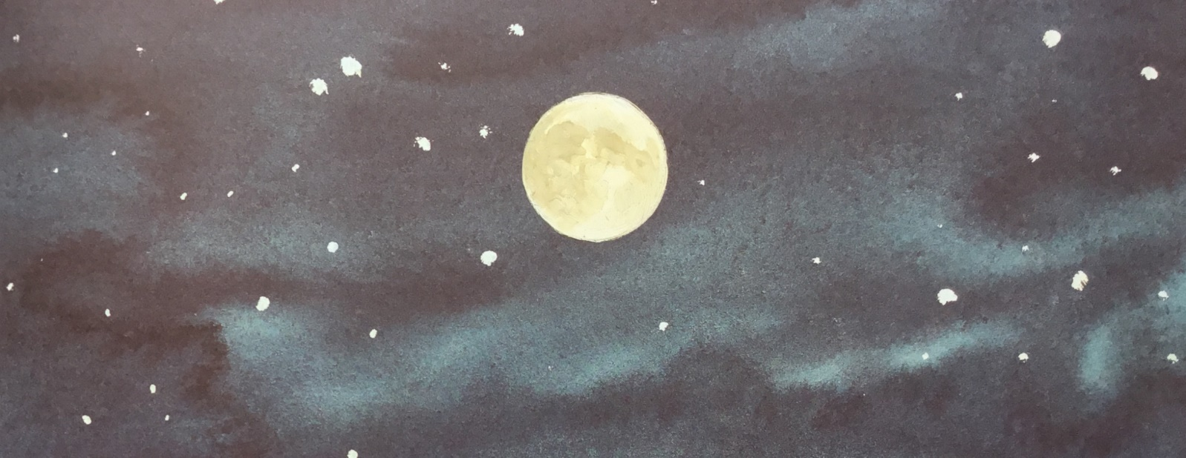
What are you?
In the darkness a blinking light
Are you a jumbo jet,
or maybe a satellite?

Slide 3
Or are you a spaceship
from a distant star?
How I wonder what you are…

Slide 4
Where is your home?
How do you shine?
I want to know
is your world just like mine?

Slide 5
If you were here
what would you say?
I want to hear
about the Milky Way

Slide 6
Now you’re not such a tiny gleam
You’re getting closer,
or have I begun to dream?

Slide 7
Hurtling towards me
through the endless night
Filling up my room with light…

Slide 8
Where is your home?
How do you shine?
I want to know
is your world just like mine?

Slide 9
If you were here
what would you say?
I want to hear
about the Milky Way

Slide 10
Where is your home?
How do you shine?
I want to know
is your world just like mine?

Slide 11
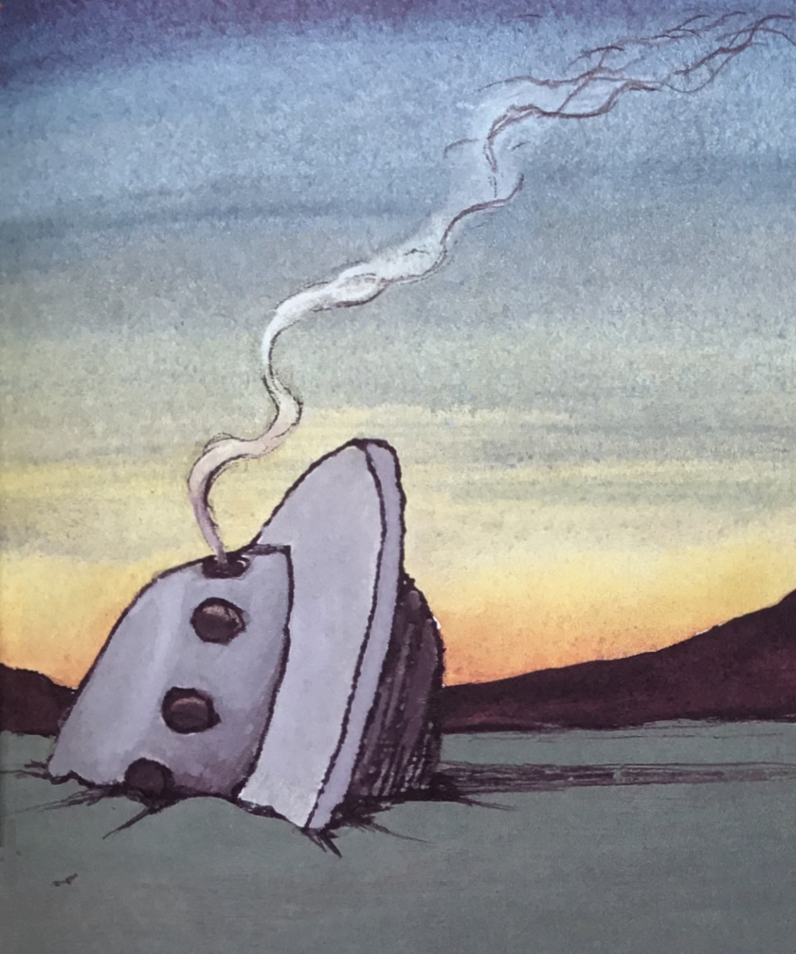
If you were here
what would you say?
I want to hear
about the Milky Way!

Slide 12
What are you?
optional extras

Slide 13
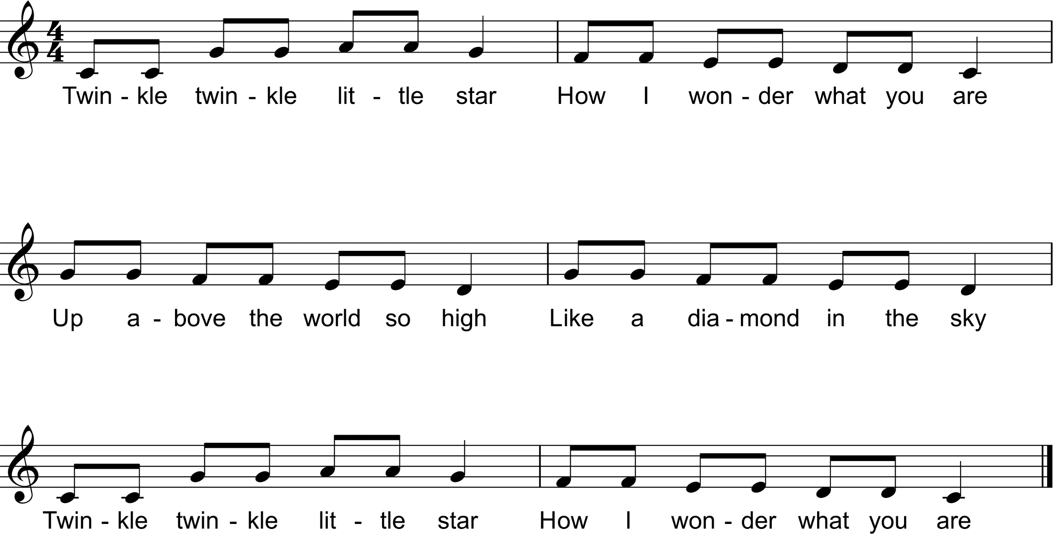
optional extras

Slide 14
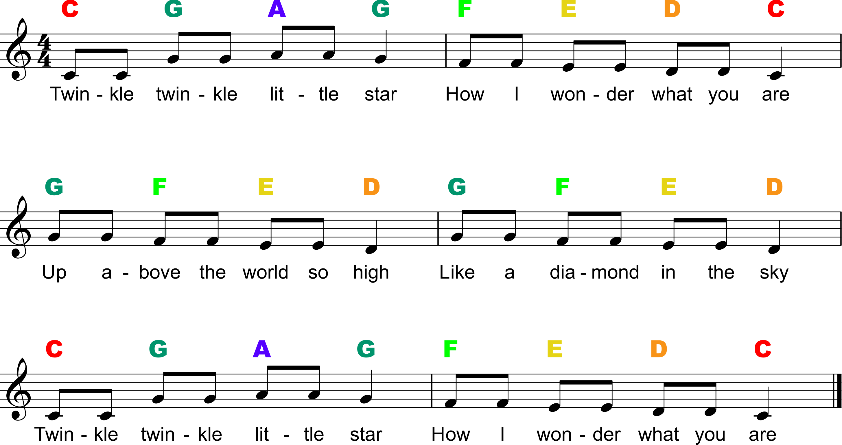
optional extras

Slide 15
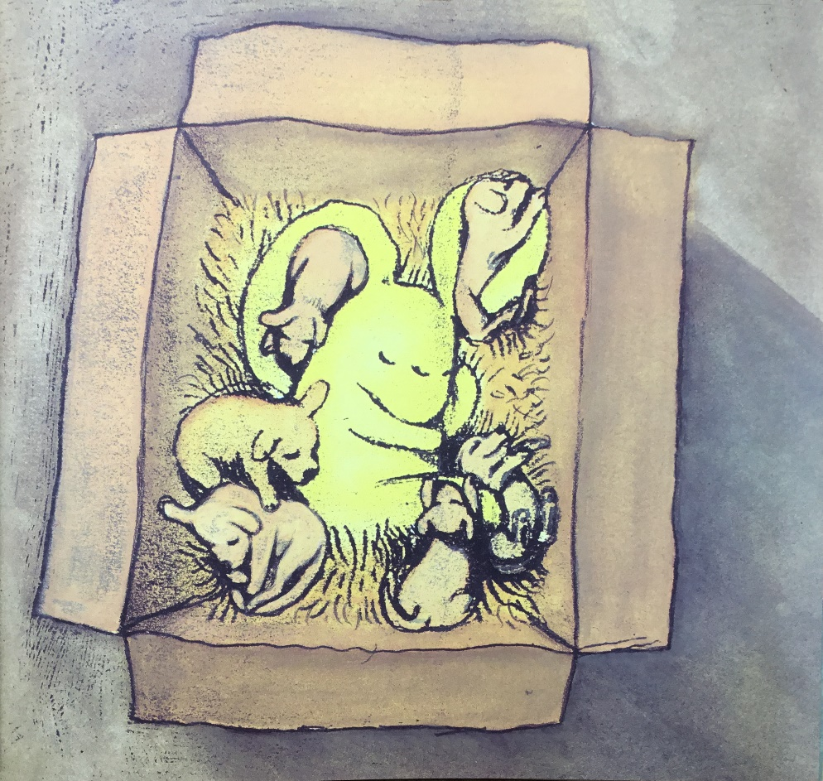
Heno, heno,
Hen blant bach
Dime, dime, dime,
Hen blant bach

Slide 16
Gwely, gwely…
Cwsgy, cwsgy… (“cussgy”)
Fory, fory… (“vory”)

Slide 17
Heno, Heno
optional extras

Slide 18
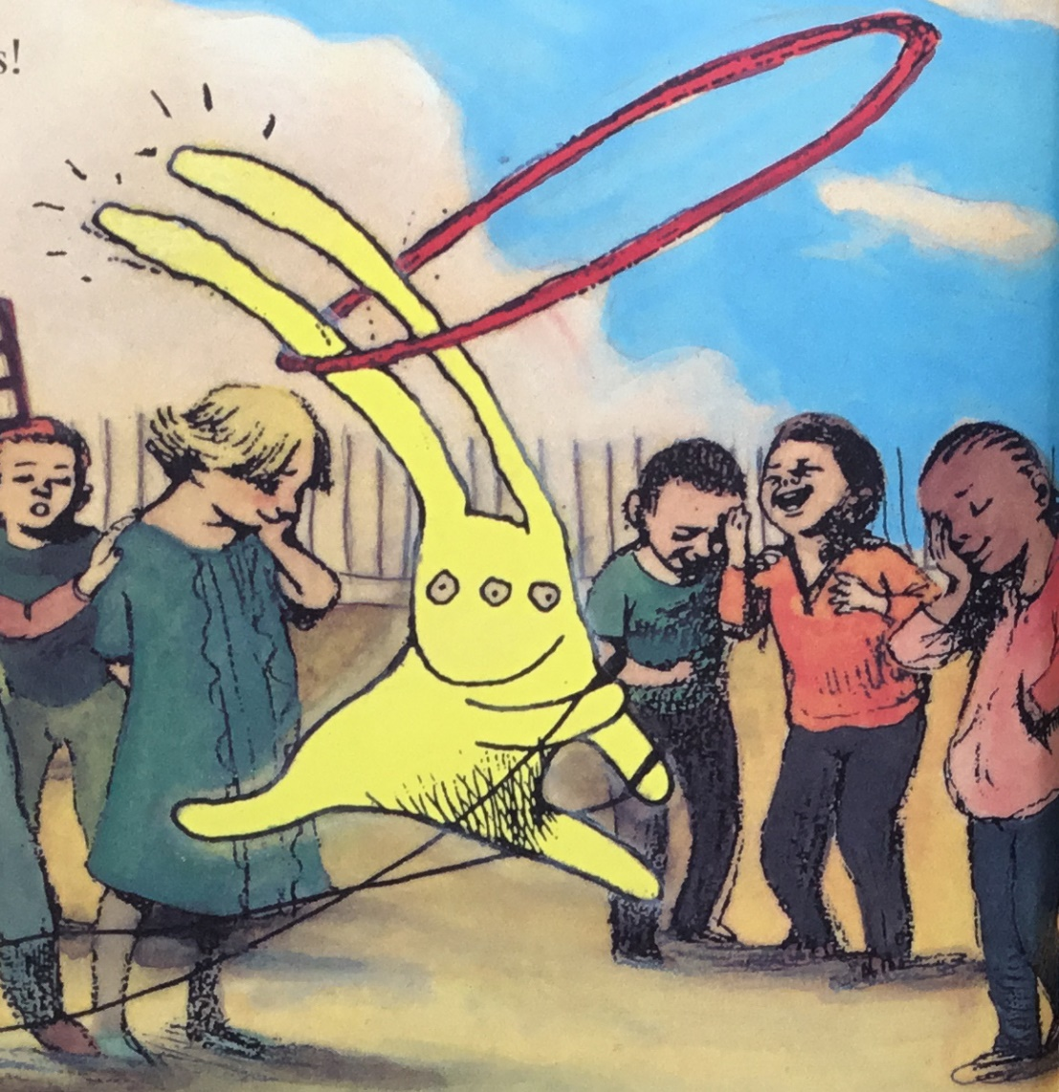
In the Playground

Slide 19
Teddy Bear, Teddy Bear…
turn around
touch the ground
tie your shoe
that will do
jump up high
wave goodbye
turn out the light
say goodnight

Slide 20
Zhǎo péngyou
Zhǎo ya zhǎo ya zhǎo péngyou
Zhǎodào yí gè hǎo péngyou
Jìng gè lǐ, wò wò shǒu
Nǐ shì wǒ de hǎo péngyou

Slide 21
A Sailor Went to Sea
A sailor went to sea, sea, sea
To see what he could see, see, see
But all that he could see, see, see
Was the bottom of the deep blue sea, sea, sea
Chop, chop, chop…
Knee, knee, knee…
Sea, chop, knee…

Slide 22
Hi Lo Chickalo
Hi lo chickalo, chickalo, chickalo
Hi lo chickalo, chickalo, hi

Slide 23
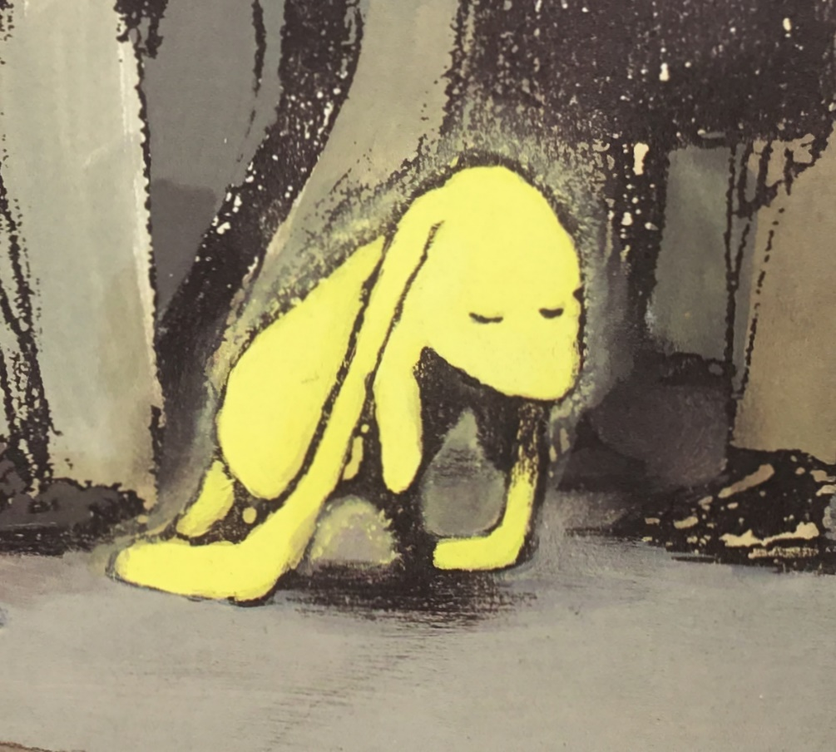
All the Difference
When things are
new and strange,
we sometimes feel that all the world is grey

Slide 24
But everything can change
with just one friend to help us on our way

Slide 25
A smile, a game to play
makes all the difference,
makes all the difference to our day

Slide 26
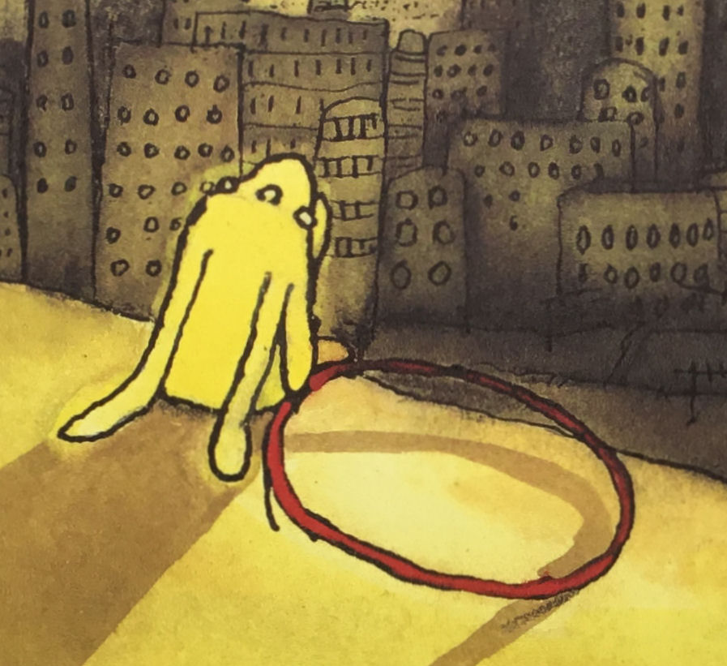
We all know how it feels
to find that we are
sitting on our own

Slide 27
So keep your eyes peeled
for people who are feeling all alone

Slide 28
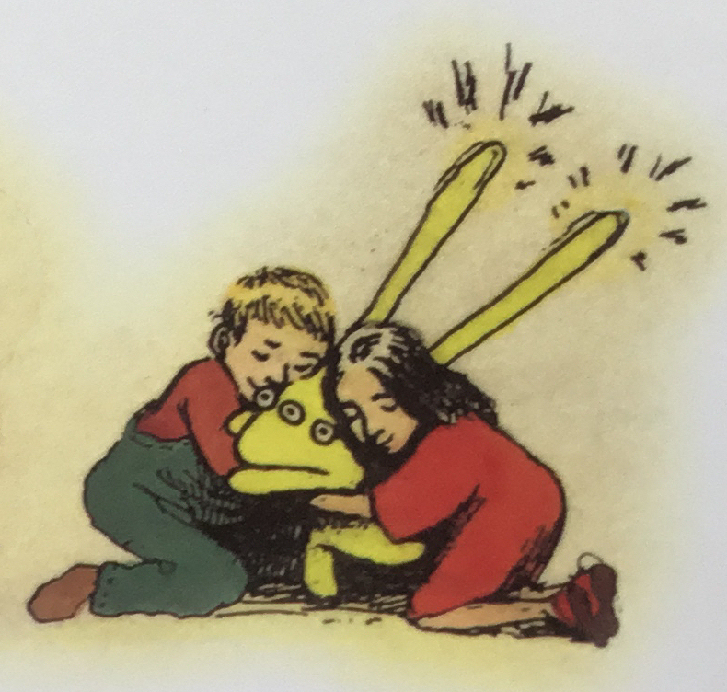
A hug, a hand to hold
makes all the difference,
makes all the difference to our world

Slide 29
And if we add together all
the things we do, the things we do
It all keeps adding up to friends
for me and you, for me and you

Slide 30
So always say “hello!”
and ask a friend how they are feeling too

Slide 31
‘Cause you may never know
the difference you can make by being you

Slide 32
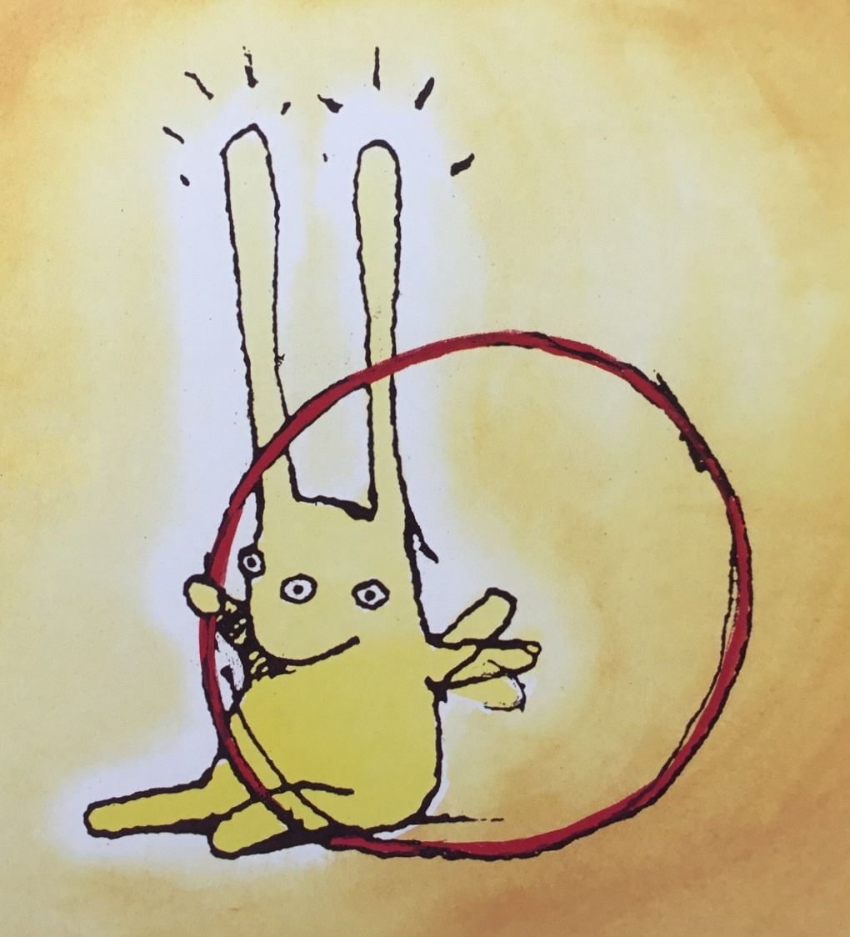
Fist bumps and high fives
makes all the difference,
makes all the difference to our lives

Slide 33
So always say “hello!”
and ask a friend how they are feeling too

Slide 34
‘Cause you may never know
the difference you can make by being you

Slide 35
Fist bumps and high fives
makes all the difference,
makes all the difference to our lives

Slide 36
