Slide 1
Additional resources for classroom activities

Slide 2
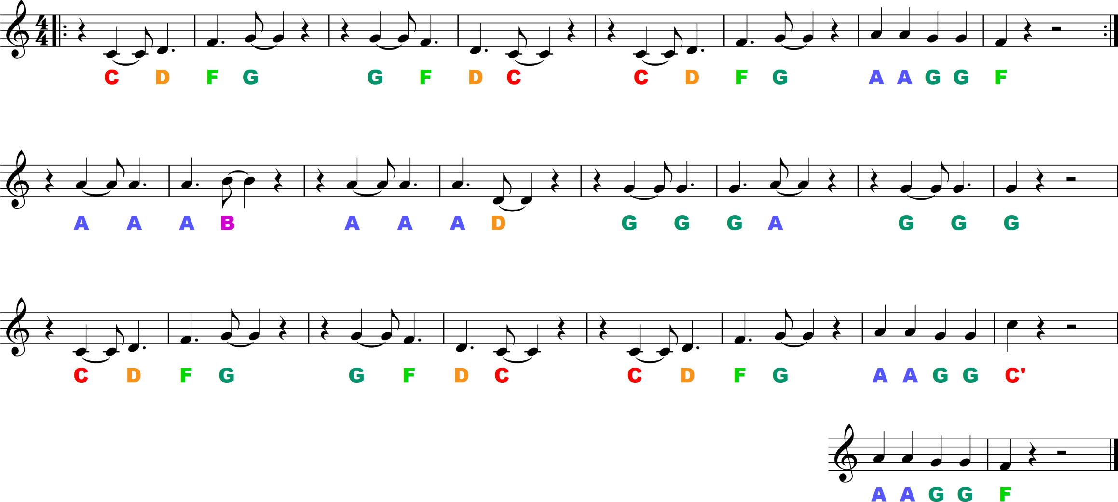
optional extras for the classroom
I Got Rhythm – melody for Tuned Percussion

Slide 3
optional extras for the classroom
Orra Bhonna Bhonnagan – melody part 1

Slide 4
optional extras for the classroom
Orra Bhonna Bhonnagan – melody part 1

Slide 5
optional extras for the classroom
Orra Bhonna Bhonnagan – melody part 2

Slide 6
optional extras for the classroom
Orra Bhonna Bhonnagan – melody part 2

Slide 7
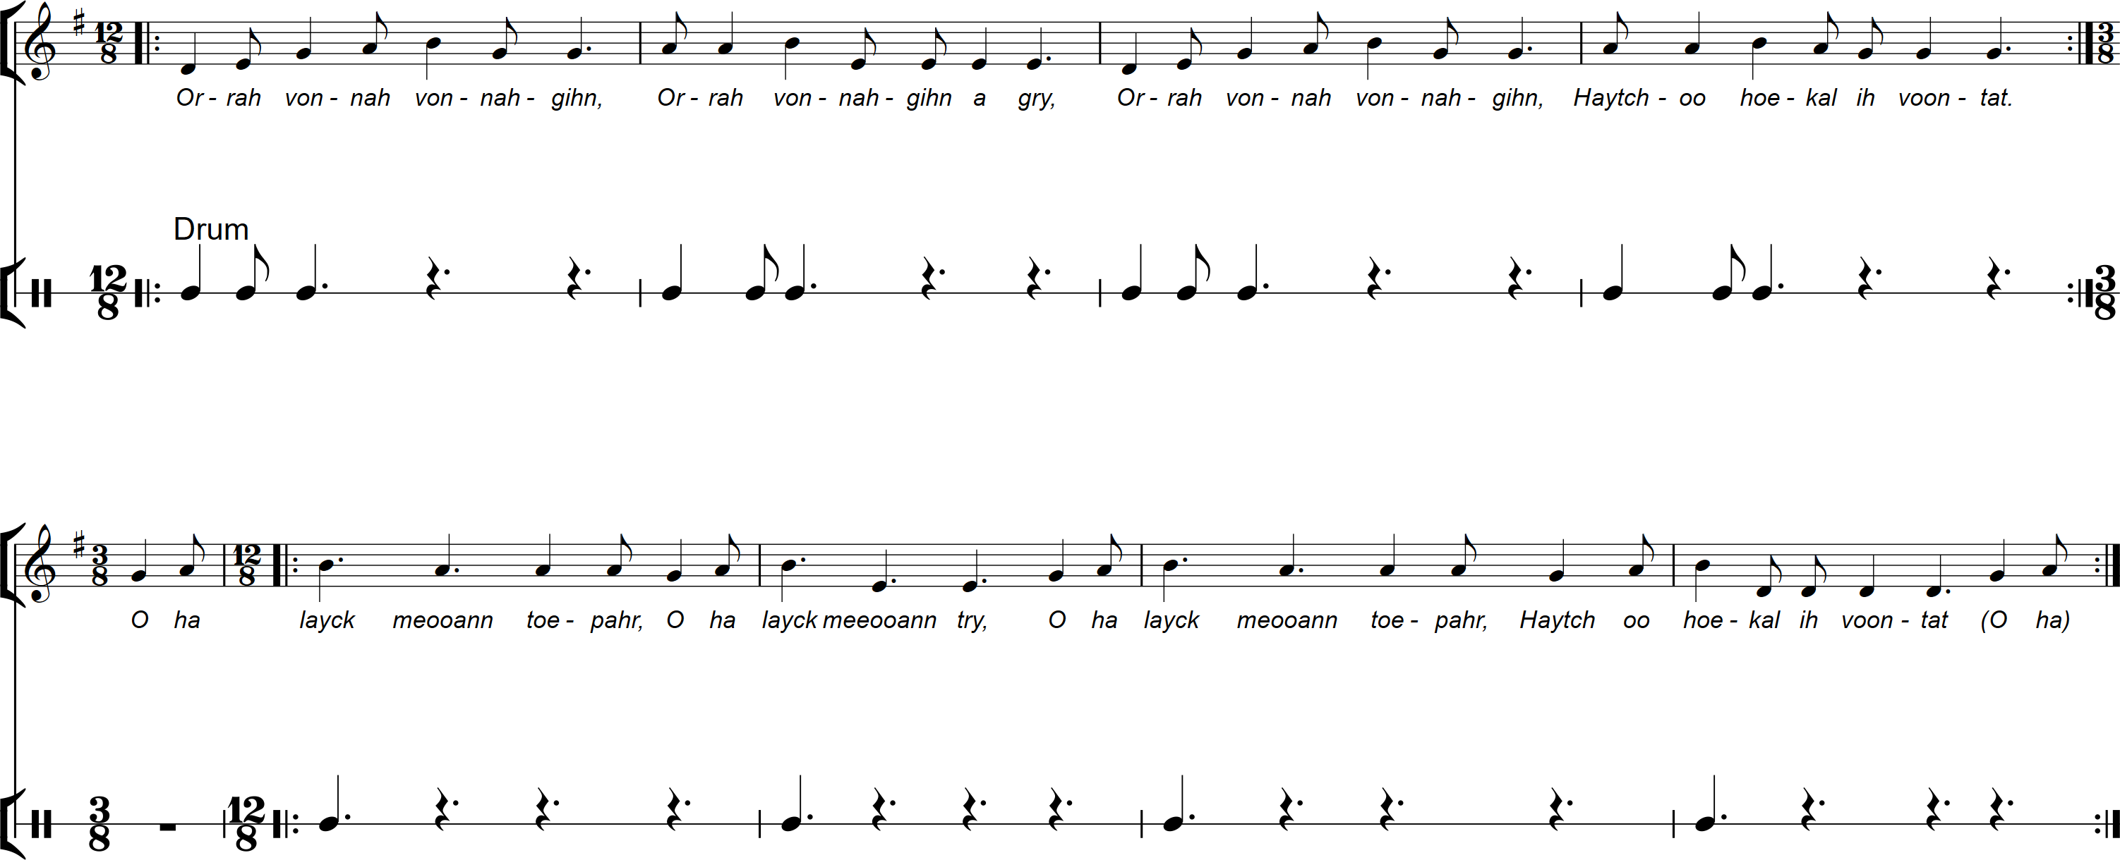
optional extras for the classroom
Orra Bhonna Bhonnagan – drum part

Slide 8
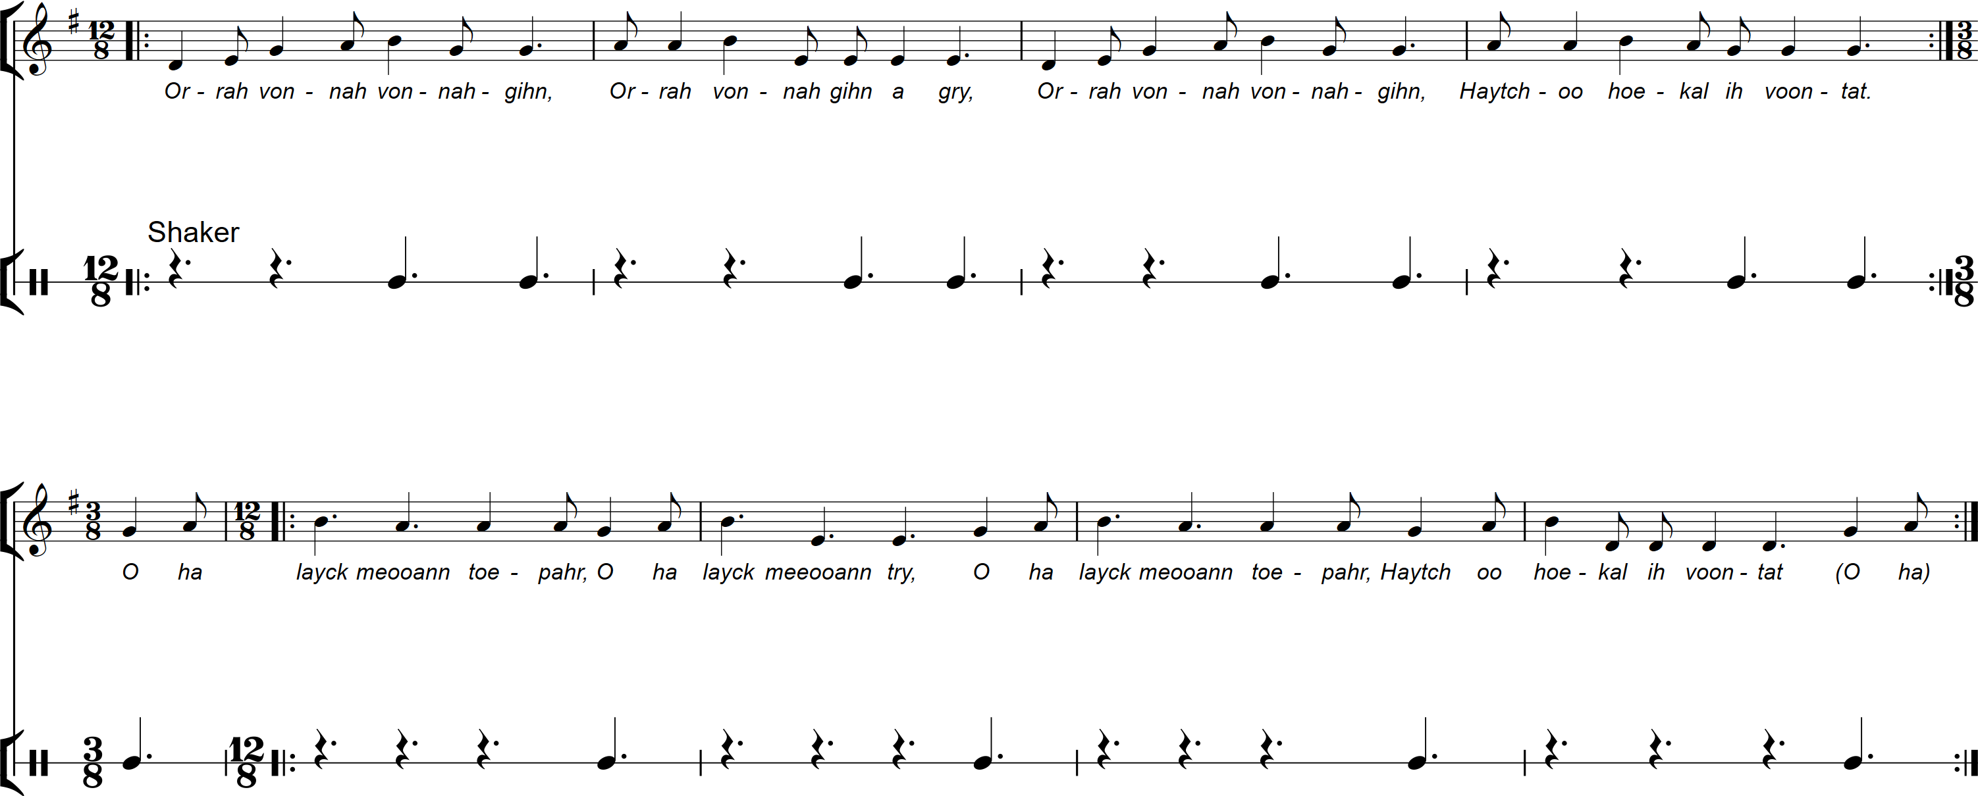
optional extras for the classroom
Orra Bhonna Bhonnagan – shaker part

Slide 9
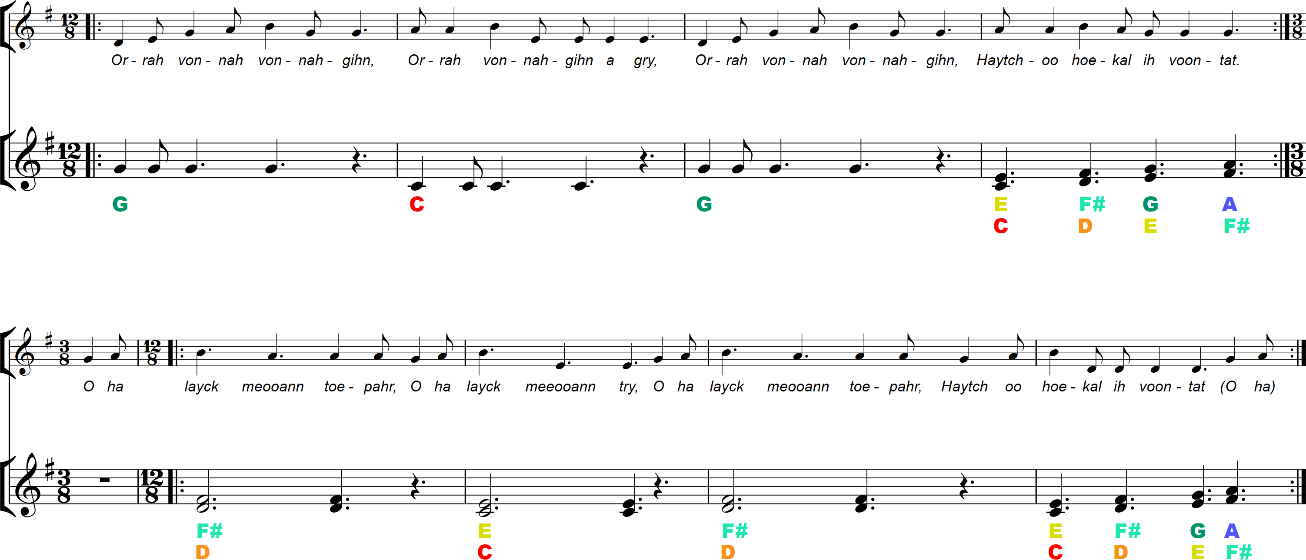
optional extras for the classroom
Orra Bhonna Bhonnagan – tuned percussion part

Slide 10
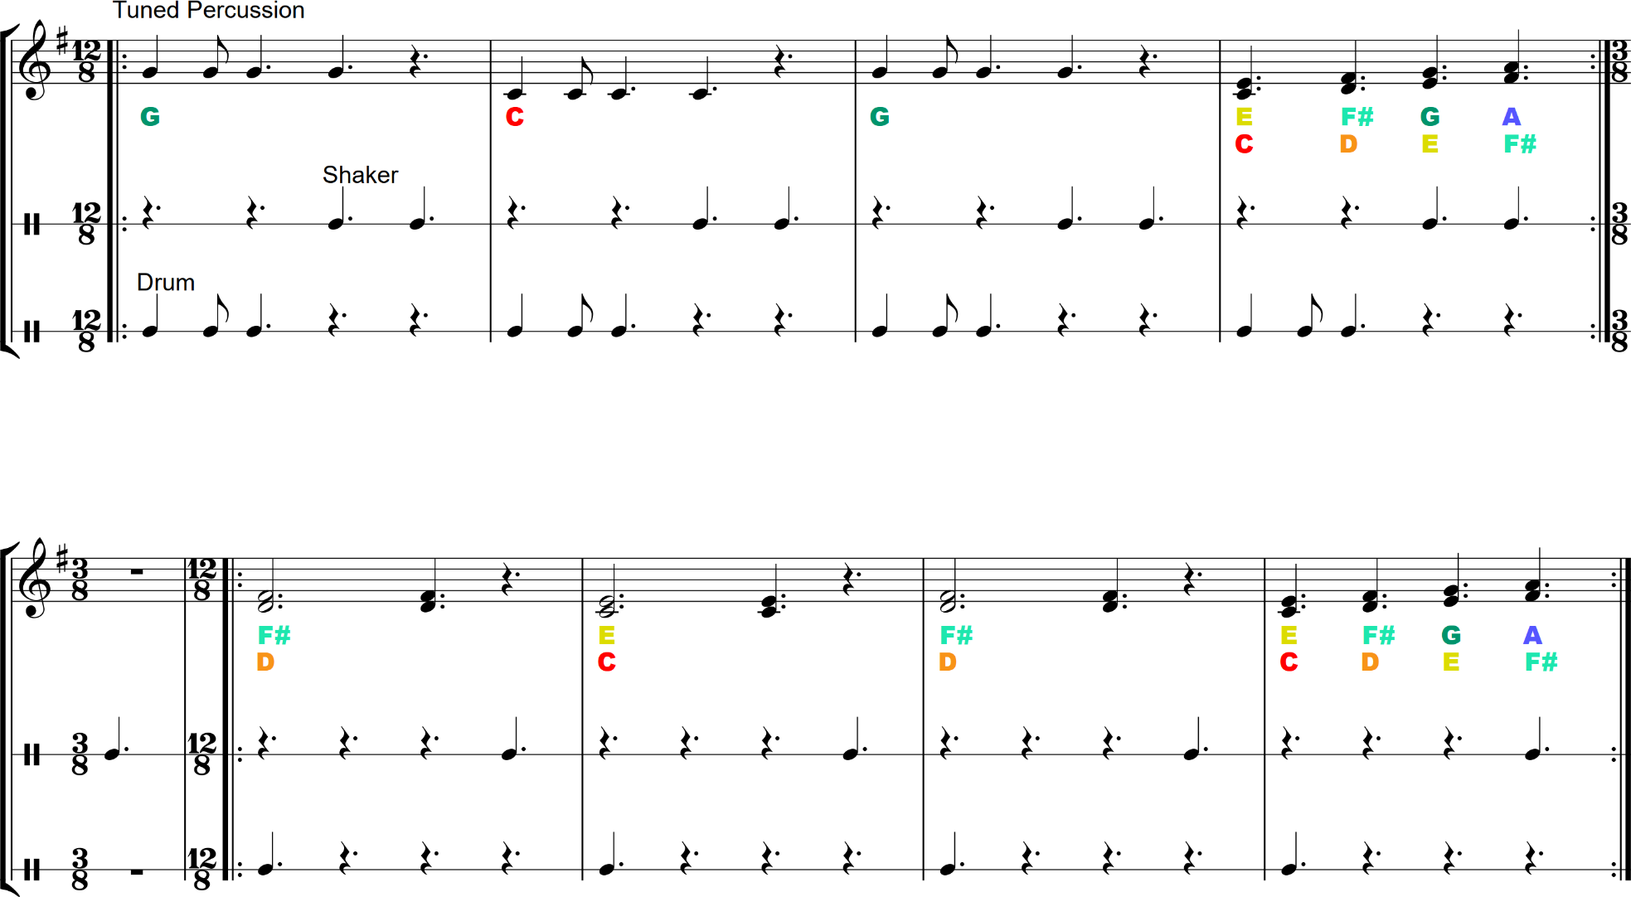
optional extras for the classroom
Orra Bhonna Bhonnagan – classroom instruments

