Slide 1
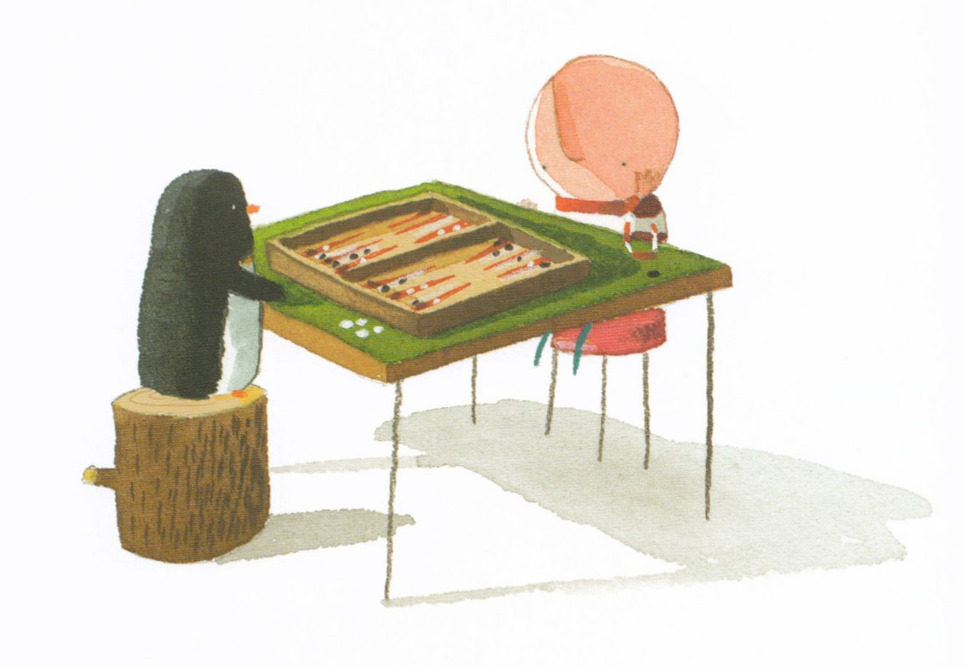
Infant Music Festivals 2023
Activities inspired Up and Down
a picture book by Oliver Jeffers

Slide 2
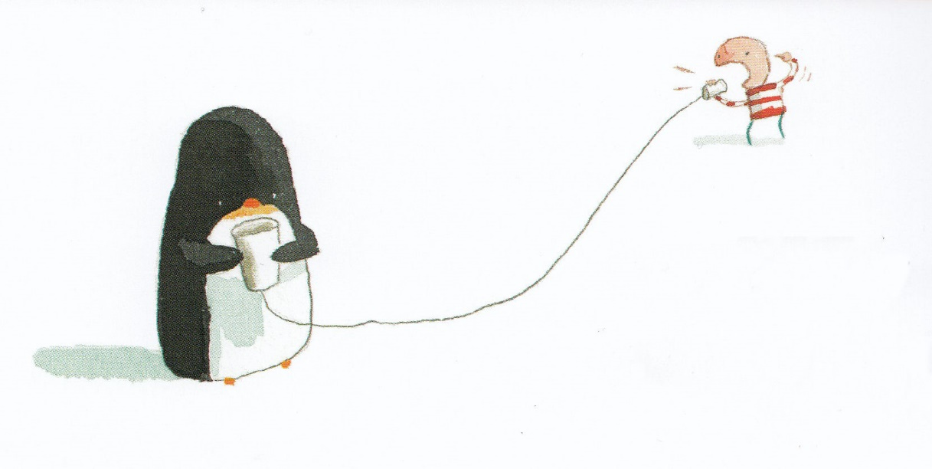
Together Wherever We Go
Wherever we go,
Whatever we do,
We’re gonna go through it together

Slide 3
We may not go far,
But sure as a star,
Wherever we are, it’s together

Slide 4
Wherever I go, I know he goes
Wherever I go, I know we go
No fits, no fights, no feuds and no egos
Amigos
Together!

Slide 5
Through thick or through thin
All out or all in
We lose or we win, but we know

Slide 6
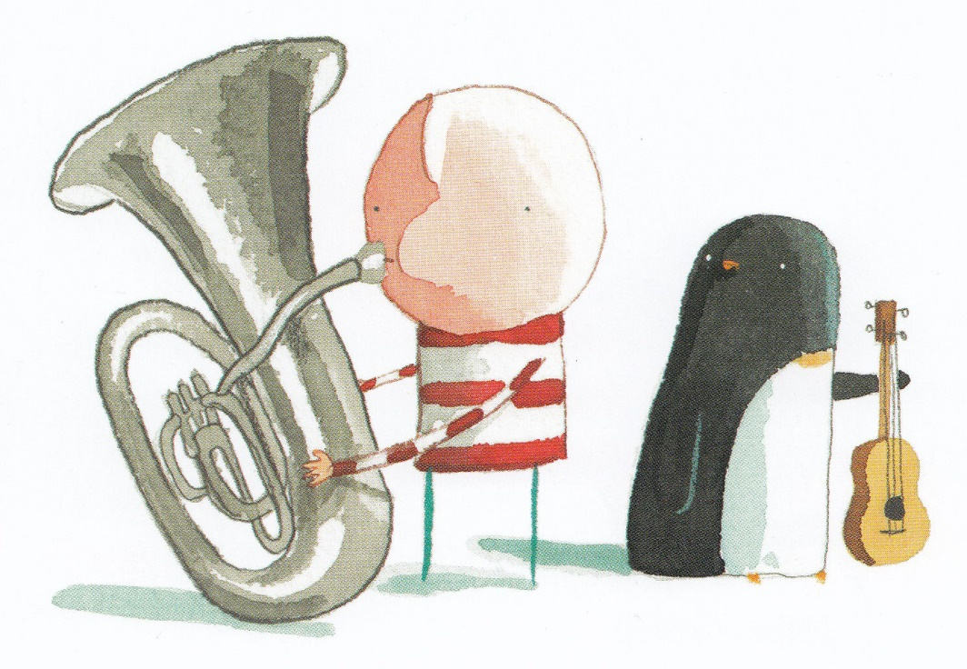
With you for me, and me for you
We’ll muddle through
Whatever we do
Together, wherever we go!

Slide 7
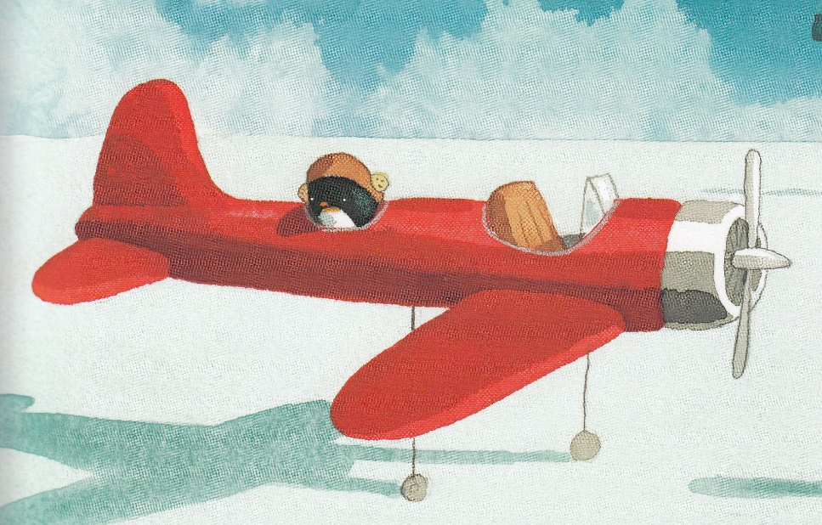
Flying Round
I’d like to fly an aeroplane,
and land it on the moon
I’d like to fly an aeroplane,
or sail in an air balloon

Slide 8
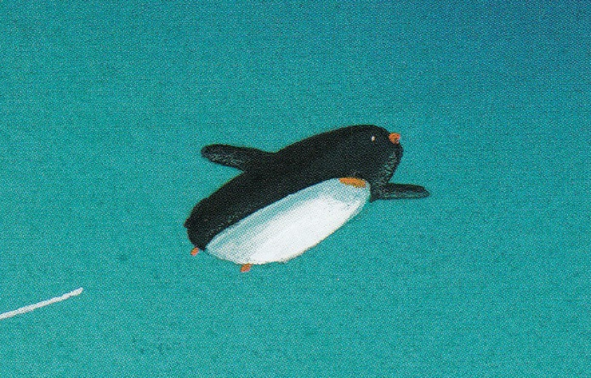
Soaring up high
in the blue sky
Gliding, swooping,
I will fly

Slide 9
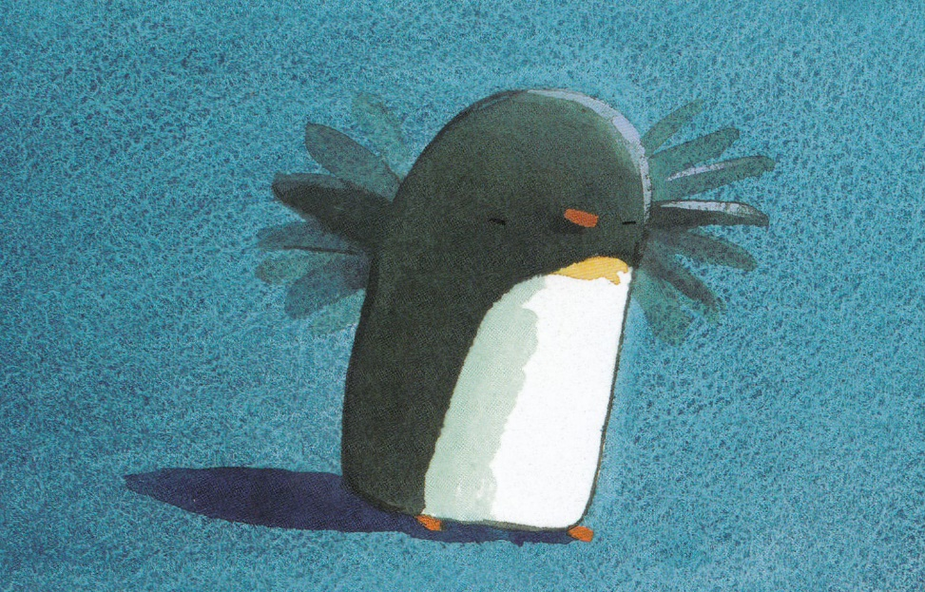
I’ll flap my wings like this
I’ll flap them up and down
Flapping my wings might just be the thing
to get me off the ground

Slide 10
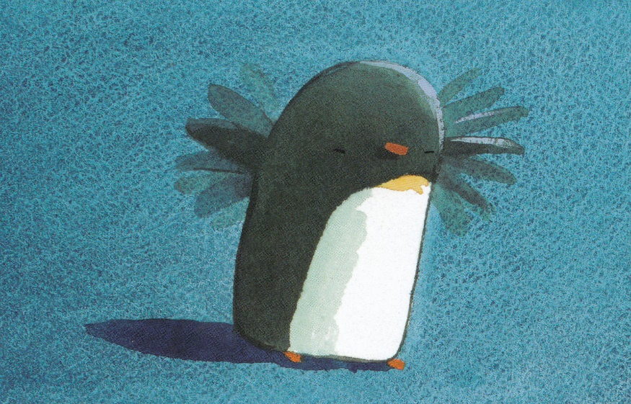

Slide 11
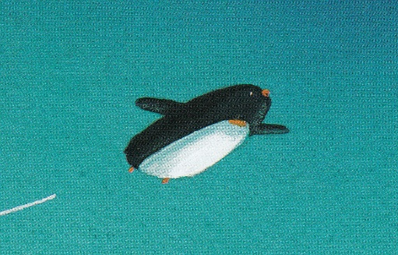

Slide 12
Flying Round
optional extras

Slide 13
Flying Round
optional extras

Slide 14
The Same Moon
Can my friend see the same moon as me?
High up above in the night’s starry sea
Do they know I can see the same sky?
Can my friend see the same moon as me?

Slide 15
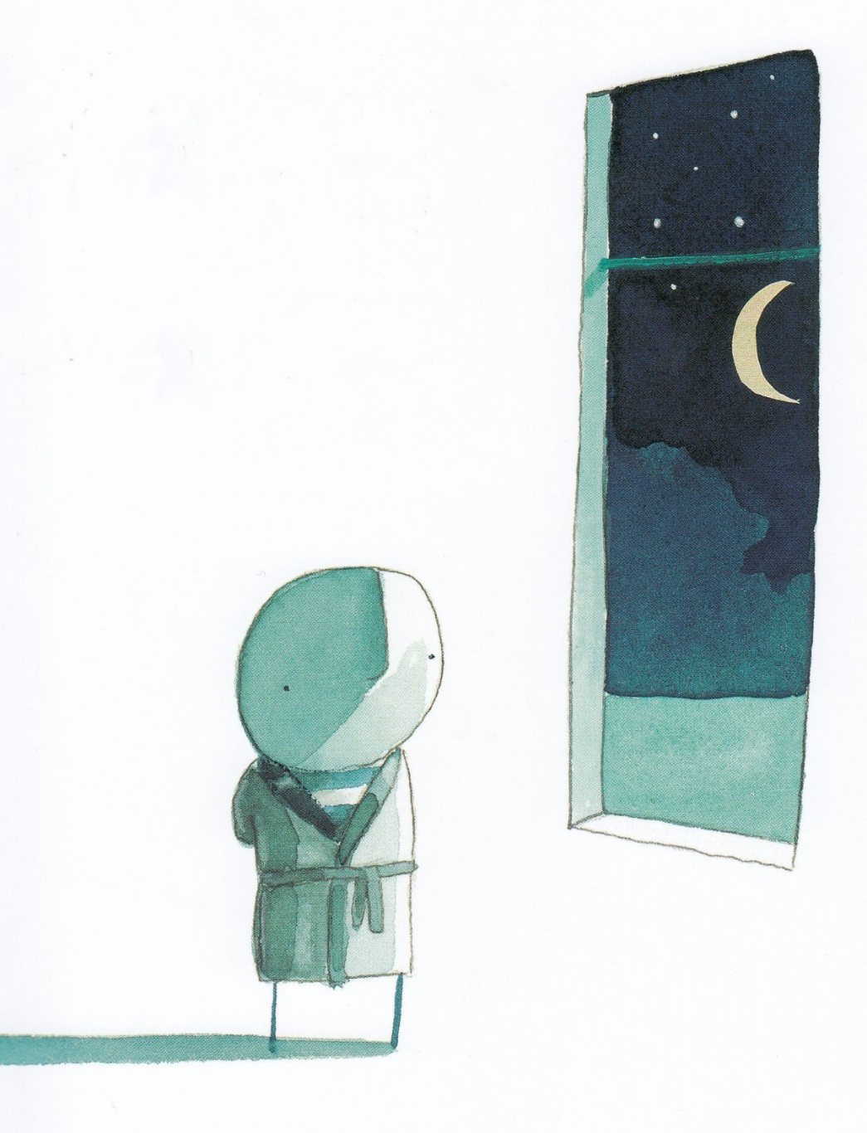
Fly up moonbeams
Shine down moonlight
Send up my dreams
Can my friend see
the same moon as me?

Slide 16
The Same Moon
optional extras

Slide 17
The Same Moon
optional extras
1
2
3

Slide 18
1
2
3

Slide 19
1
2
3

Slide 20
Can
my
friend
see
the
same
moon
as
me?

Slide 21
High
up
a -
bove
in
the
night’s
star -
ry
sea

Slide 22
Do
they
know
I
can
see
the
same
sky?

Slide 23
Can
my
friend
see
the
same
moon
as
me?

Slide 24
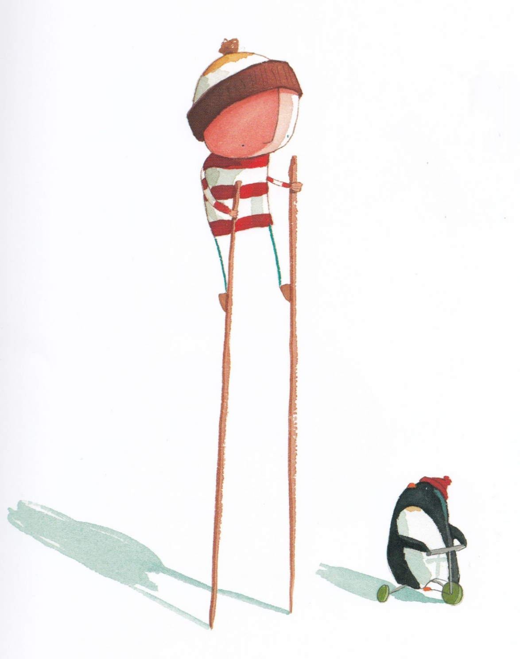
Thank you for being a friend
Thank you for being a friend
Travelled down the road
and back again
Your heart is true, you’re a pal
and a confidant

Slide 25
I’m not ashamed to say,
I hope it always will stay this way
My hat is off, won’t you stand up
and take a bow

Slide 26
And if you threw a party,
Invited everyone you knew
You would see the biggest gift
would be from me
And the card attached would say

Slide 27
Thank you for being a friend
Thank you for being a friend
Thank you for being a friend
Thank you for being a friend
I wanna thank you
I wanna thank you
I wanna thank you

Slide 28
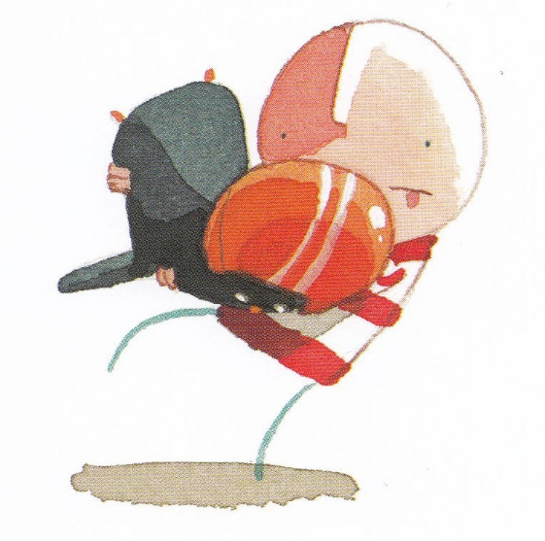
If ever you have a dream
I’ll be there however hard it seems
If things go wrong,
I will catch you when you fall

Slide 29
I’m not ashamed to say,
I hope it always will stay this way
My hat is off, won’t you stand up
and take a bow

Slide 30
And when we both get older,
With walking sticks and hair of grey
Have no fear,
Even though it’s hard to hear,
I will stand up close and say

Slide 31
Thank you for being a friend
Thank you for being a friend
Thank you for being a friend
Thank you for being a friend
I wanna thank you
I wanna thank you
I wanna thank you
I wanna thank you

Slide 32
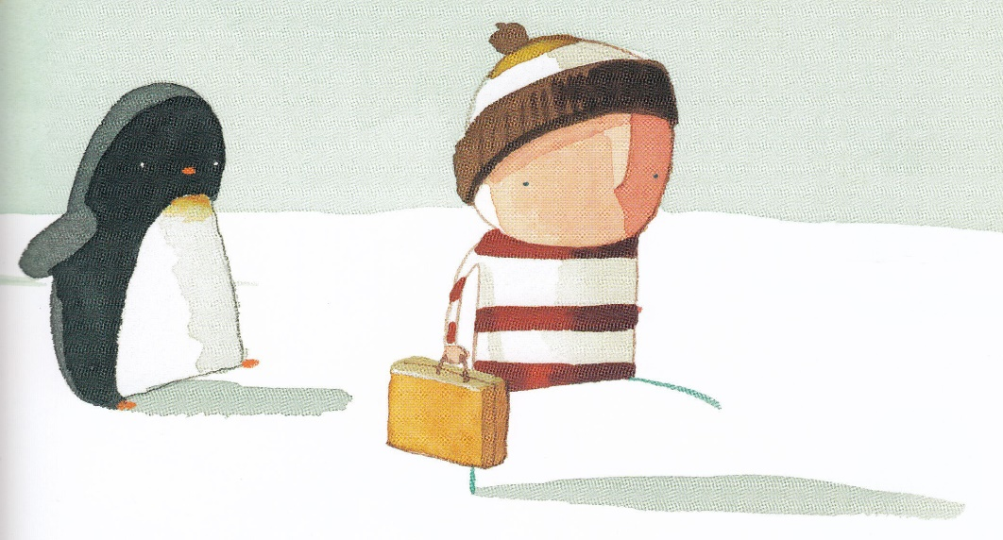
Thank you for being a friend
Thank you for being a friend
Thank you for being a friend
Thank you for being a friend
I wanna thank you
I wanna thank you
I wanna thank you

