Slide 1
Embedding inclusion and diversity in your teaching practice
Sam Spence and Abigail D’Amore

Slide 2
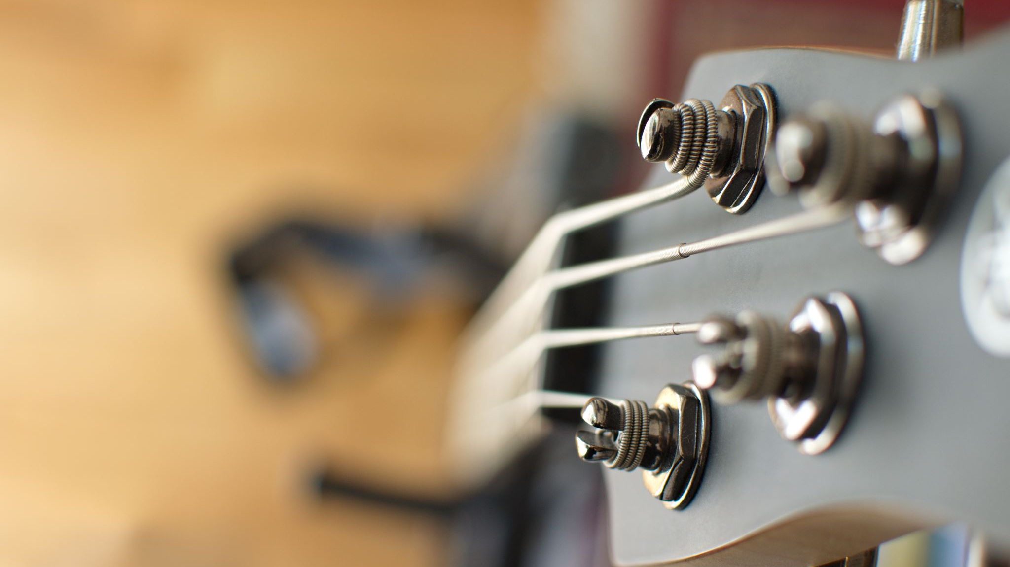
Perspectives and musical journeys

Slide 3
Reflection 1
How are these recent events relevant to Music Education and the work you do?
In what way, as a sector, can we start to have meaningful conversations which challenge outdated narratives in instrumental teaching and music education?

Slide 4
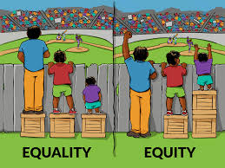
What do we mean?
Inclusion
Musically inclusive practice ensures that all children and young people who want to can make music. (Youth Music)
Equality and Equity

Slide 5
What do we mean?
Structural racism
System and organisational racism
Decolonising the music curriculum (see Nate Holder and Diljeet Bhachu)

Slide 6
What do we mean?
Unconscious bias
Intersectionality

Slide 7
Whose Music is it anyway?
SELF
PUPILS
What do you play? Listen to?
What music is part of your musical identity?
What do you teach?
What are you expected to teach?
What do you choose to teach?
What do you feel comfortable teaching?
What should you teach?
What could you teach?
What don’t you teach?
What is missing from the music you teach?
Do you see yourself in the music you teach?
Do you see your pupils in the music you teach?

Slide 8
What’s in your Music Toolbox?
What’s out of date?
What no longer aligns with you and your values?
What is culturally inappropriate?
What substitutions can you make?
What do you need to add? What’s missing?
What is unknown?

Slide 9
M
Mindful of Thoughts
Be aware of any unconscious bias, conscious bias and limiting beliefs. Observe what they are, question and take note.
U
Understand first before seeking to be understood
Turn up the empathy dial and really try and listen to and understand the perspective of others before trying to get them to understand you.
S
Speak Up
If you see or hear anything which doesn’t sit right or creates a barrier for certain groups, speak up. Being silent does nothing.
I
Independence from narratives and programmes
Challenge the narratives which dictate what you should and shouldn’t teach or outdated ones irrelevant to today’s society
C
Conscious conversations
Specifically with groups of people or pupils you seek to understand more about. Don’t shy away from challenging ones.

Slide 10
Youth Voice and Participation
“Nothing about us without us”

Slide 11
UN Convention on the Rights of the Child
Article 12
“Every child has the right to express their views, feelings and wishes in all matters affecting them, and to have their views considered and taken seriously. This right applies at all times, for example during immigration proceedings, housing decisions or the child’s day-to-day home life.”
Article 5
“Governments must respect the rights and responsibilities of parents and carers to provide guidance and direction to their child as they grow up, so that they fully enjoy their rights. This must be done in a way that recognises the child’s increasing capacity to make their own choices.”

Slide 12
Starting a dialogue
Make time
Concern for welfare
Be clear on ‘why now?’
Mindful of privacy and sensitivity
Introvert and extrovert
Active listening

Slide 13
Voice and choice
What are the children and young people you work with interested in?
What do they think about the music they learn?
Does their cultural background impact on the choices they are able to make with music learning?
How do they prefer to learn?
What might be the barriers to engaging in learning?
How might increased student voice and choice remove barriers?

Slide 14
Hierarchy and power
How are you consulting?
Framing questions
Not necessarily about handing over power
Who is the expert?

Slide 15
Questions and reflections for us?

Slide 16
Questions and reflections for you
Music Education Consultant Nate Holder wrote a poem in July called ‘If I were a Racist’:
https://www.nateholdermusic.com/post/if-i-were-a-racist
We would like to ask that you read this poem, and reflect on the following after the session:
How can you use your position as a music educator to prioritise humanity, truly celebrate diversity and acknowledge the range of experiences pupils bring to school with them?
Are there musical narratives you have grown up with which present certain groups and genres as more important than others?
What might be the barriers to the children and young people you teach sharing and expressing their views in the way that Nate shared his?

