Slide 1

MOD Schools
Music Service
Jon Kille – Head of Service

Slide 2
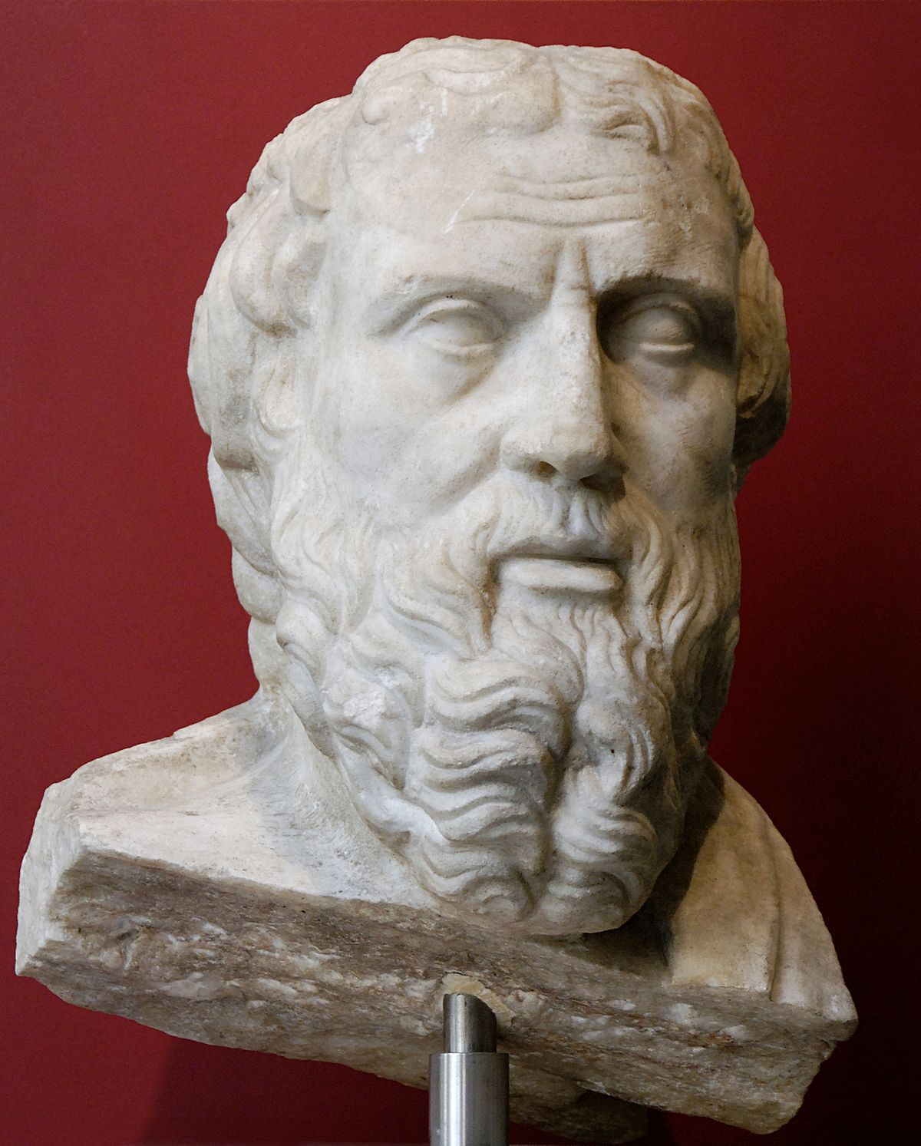

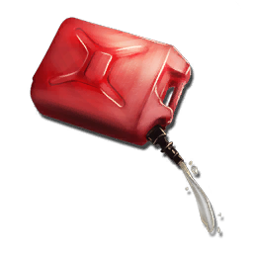


‘The mind is not a vessel that needs filling, but wood that needs igniting’
Plutarch
Musical ‘weather’
Create a cultural framework
(protects like an umbrella
against the rain)
Inspiration
Enjoyment
Fun
Success/Achievement
Encouragement
Advice
Praise - appropriate
Once the coals get going,
they only need a little attention
-Independence

Slide 3
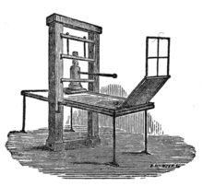

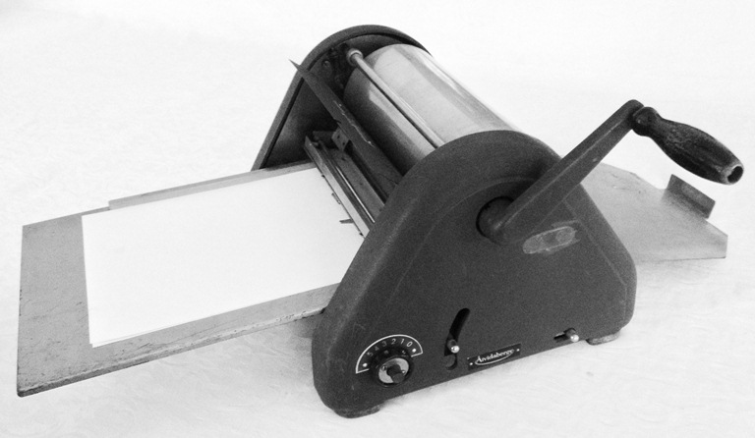
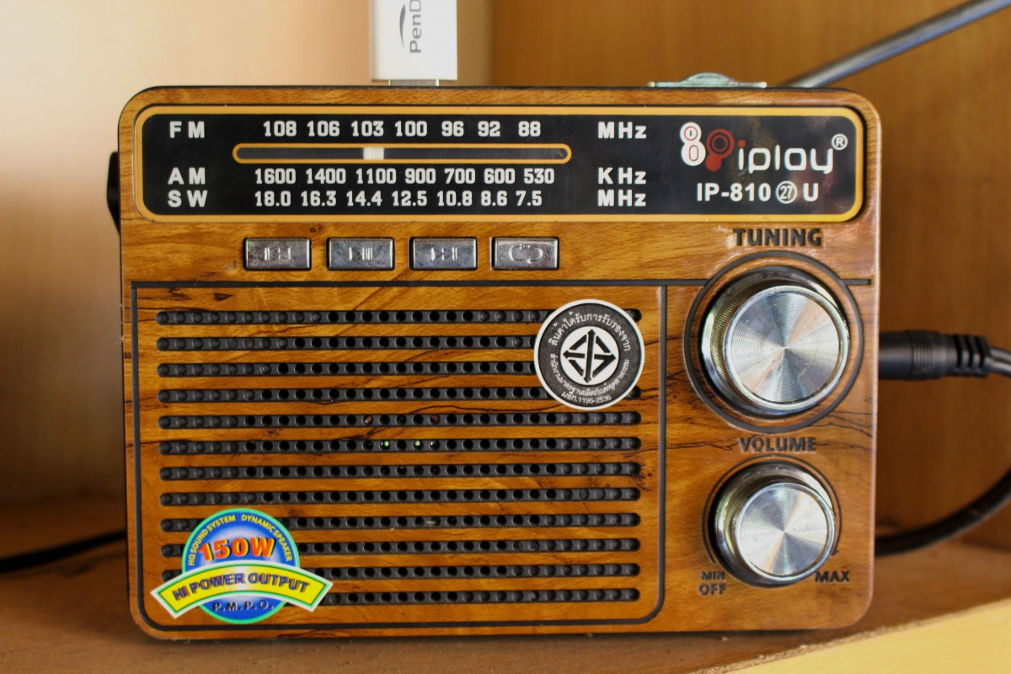
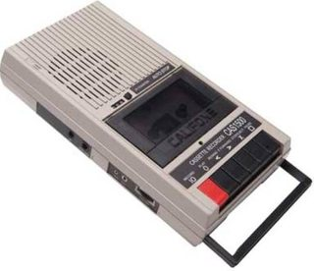

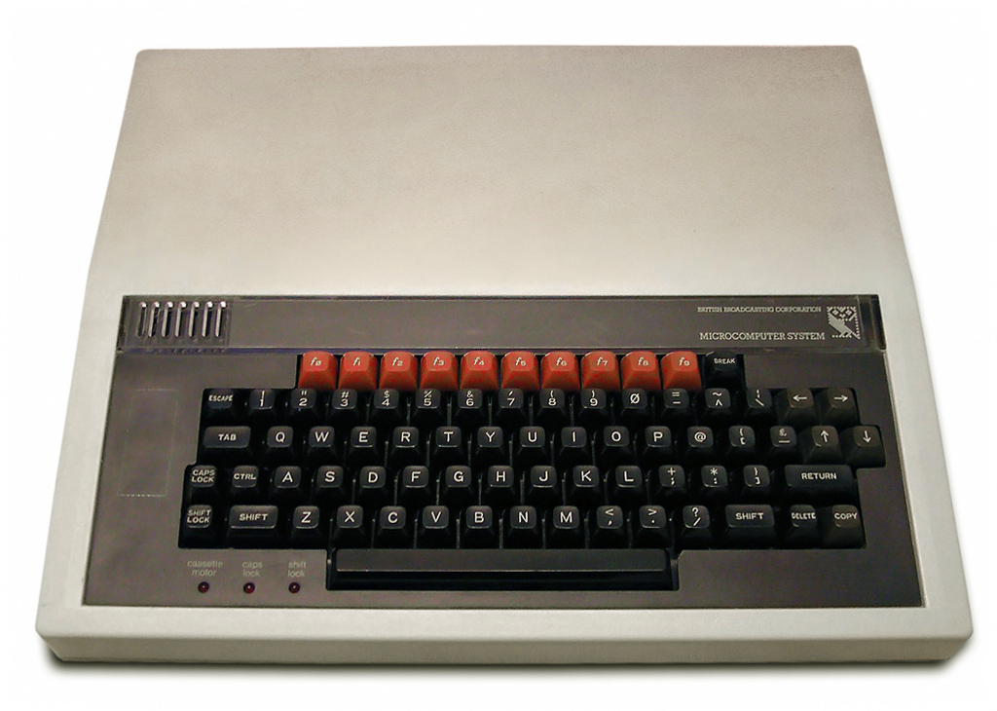

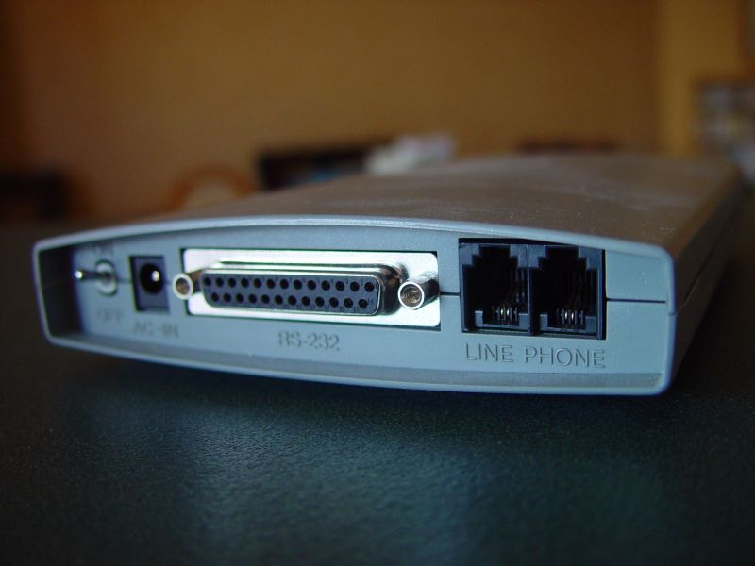
New Technology?

Slide 4
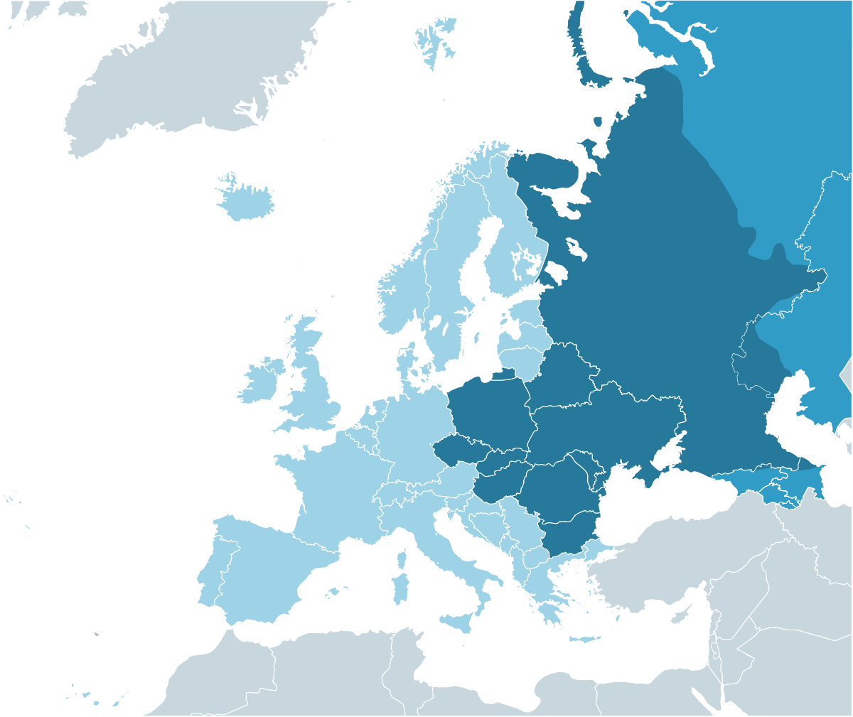

Slide 5
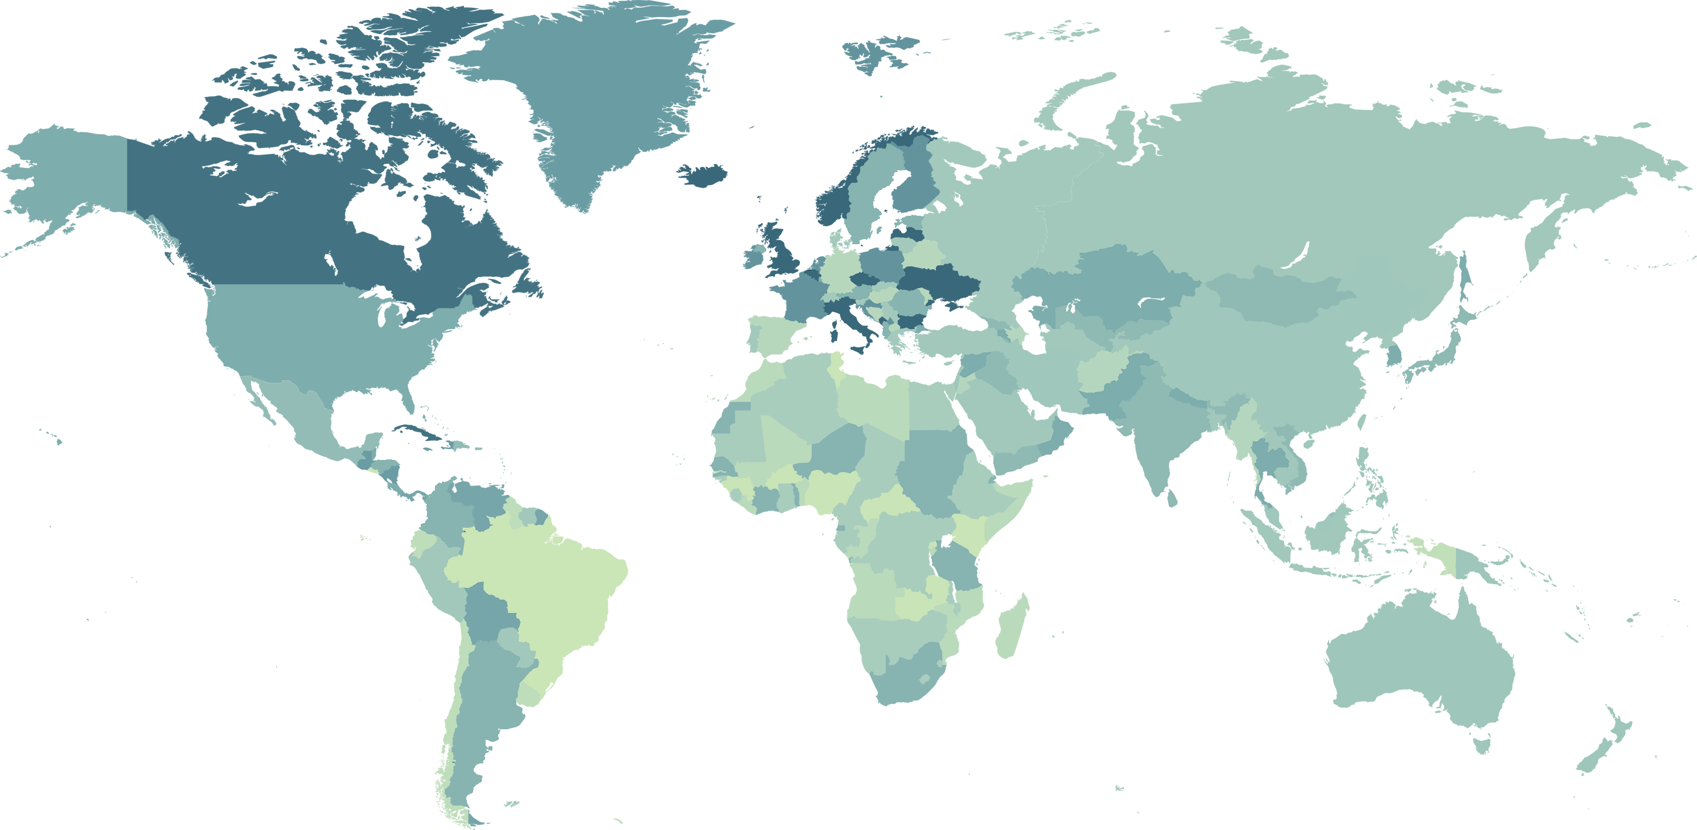

Slide 6

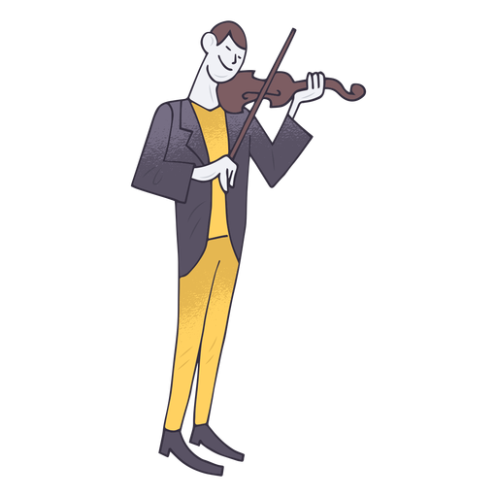
Violin ‘Wider Opportunities’ Lessons Y3/Y4 v1.1 2005
Stand Up
Movement
Warm-ups
Aims and Objectives
Singing
Lots of time
Lots of time
Sit Down
Written, standard notation (from the start)
Posture
Bow hold
Stay still
Technique

Slide 7



In Came….
Singing – simple, catchy songs that could be enhanced by all sorts of simple accompaniments – throughout the lesson and the basis of most of the lesson activity – it’s a great team exercise to take a song and brainstorm how many ways it could be used and extended to provide relevant activities in the lessons
Notation – used as a practical, visual guide to remind pupils how the piece / activity goes. Aide memoire, not for the sake of it
Improvisation – using any new note/bank of notes – ‘make up’ – appropriate to current activities (Stay out of the ‘scary zone’ as much as possible) – learn to play the ‘head’ of a piece (perhaps a simple pentatonic melody as part of a wider topic - and build in a repeated improvisation section
Technique – how to play the notes needed to complete the activity; listen for the ‘best’ sound; posture; dynamics;
Listening and analyzing – does the sound you are making sound good to you? If not, why not? When we play together, what could be improved? What about the others - how could you help?
Independence – simple extension of single lines to multiple lines to be played independently and simultaneously. Appropriate to current lesson activities
Composing – always appropriate level depending on new skills learnt (FS Scary Castle)
Movement activities – linked to the current activities, less ‘standalone’. e.g. Clapping games, playground games
Performing – aiming for as many ‘complete’ performances as possible (in class)

Slide 8



One lesson / 6 lessons / A term of lessons
Independence
End of ‘Programme’
B
B
Red A – scary zone
A
A
Start of ‘Programme’
Independence
Green = skill/knowledge level
Green B = independent ability

Slide 9



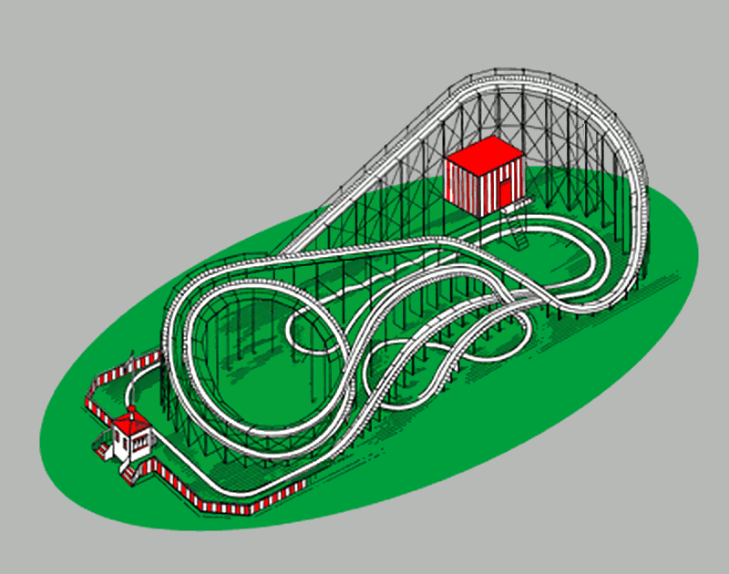
The Most Amazing!!
We are going to:
a. Create an advert for Epic Wildlife Park
We will use:
i) Drummer ii) Song sections
iii) Tempo Change iv) Sampler
v) Audio Recorder vi) Chords (autoplay)
We will learn to use:
i) Panning
This Photo by Unknown Author is licensed under CC BY-SA

Slide 10

What we will do
1 | Create a new song
2 | Create a suitable drummer track – tempo 128 – about 40 seconds – (20-24 bars)
3 | Rewind
4 | Track view; add a track; choose Bass; using any (one) chord on autoplay, record 24 bars to go with your drum track; keep it simple (unfussy)
5 | Track view; add a track; choose keyboard – Smart Piano; using the same chord on autoplay record 24 bars to go with your other 2 tracks
6 | Track view; add a track; choose Audio Recorder - record the narration
7 | Track View – create suitable sample and use – repeat as needed
8 | Listen to your track – mix + pan - evaluate

Slide 11
NARRATION:
This Summer, why not visit the most amazing new adventure park to open since Disneyland!
Visit the crazy monkey enclosure
Or perhaps dare to hold a live viper or cobra in the sizzling snake enclosure
See the lions roaming and feeding in the specially created jungle area, watch out for the insects though!
Or take a trip on the death defying rollercoaster with 12 separate back loops and 2 vertical drops into darkness….
Visit the Epic Park – you won’t have a better day anywhere else this year – if you survive…!

Slide 12

Structure
Sample
Sample
Sample
Sample
Narration
Drummer
Keyboard
Bass

Slide 13
One lesson / 6 lessons / A term of lessons
Independence
End of ‘Programme’
B
B
Red A – scary zone
A
A
Start of ‘Programme’
Independence
Green = skill/knowledge level
Green B = independent ability

Slide 14


Getting organised
Vision | Skills | Incentives | Resources | Action Plan
Success
What’s in it for me?
Instruments?
Detailed, but don’t go crazy
Inspiration - I have a great idea!
What do we need to know/understand/be able to do?
Performance Management/Appraisals
Clear workflow and timescale outline
Technology / Hardware – IT, Recording?
Aspiration - I think it could be done like this – I want it
to be done like this
Teaching skills/process?
Use of technology?
Personal development
Aims and Objectives
Applications / Software?
Knowledge of subject/instrument?
Who is doing what (including the children)? When?
Outline of Details - We’ll do this, We’ll do that…
Personal interest/satisfaction
Teacher support?
Knowledge of school’s/National curriculum?
Actual – TLR etc
Expected Results – This is what I’ll be aiming for
Copies of documentation?
Copies of documentation?
Underlying philosophy/pedagogy?
Other

Slide 15





Getting Disorganised
Vision | Skills | Incentives | Resources | Action Plan
Success
 | Skills | Incentives | Resources | Action Plan
Confusion
Vision |  | Incentives | Resources | Action Plan
Anxiety
Vision | Skills |  | Resources | Action Plan
Resistance
Vision | Skills | Incentives |  | Action Plan
Frustration
Vision | Skills | Incentives | Resources
Diffusion

Slide 16
Distance Learning -Underlying Essentials
Relationship with head teacher
Relationship with class teacher
Relationship with children
Agreement for ‘live’ visit - essential
Timescale agreement – in context

Slide 17
Delivery -Practical Essentials
Really (really, really really) know your materials – ‘winging’ online class lessons
is just not an option. Visualise, practice, run through in your mind - is there flow?
If flow does not seem natural, or is not present, then do something about it.
Aim to have the entire lesson recorded into one slide/set of slides
Use one preferred means of display – e.g. Powerpoint.
Keep it simple i.e. don’t try to mix-and match displays
Learn the ‘advanced basics’ – embed audio (and perhaps video);
Import graphics; animations; links;
Recording audio; Audacity; Garageband; use a quality handheld recorder;
learn how to use it really well in different circumstances;
Backing tracks – always try to do your own to suit; keyboard automated;
Garageband; play live; sing along; different tempos;

Slide 18
‘The mind is not a vessel that needs filling, but wood that needs igniting’
Plutarch

Slide 19


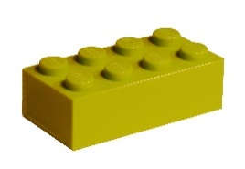


The Inter-related Dimensions
of Music
MUSIC
Rhythm
Pitch
Tempo
Melody
Harmony
Timbre
Dynamics
Silence
Duration
Structure
Texture
PULSE

Slide 20


Bang Sizzle
Melody
Popo –cata – petl is a big volcano
Far away in Mexico
Popo – cata - petl, Old
Popo – cata - petl goes
Bang! Sizzle Sizzle Bang!
So you won’t forget that...
Watch a video about the volcano
F Chord
C Chord
Harmony

Slide 21

1
2
Rhythm
3
4
Big volcano
Popocatapetl
Challenge Time!
Far away in Mexico
Bang, sizzle sizzle Bang!

Slide 22







Just Backing Track
With Help
Popo | cata | Petl | is a | big | vol | can | o
Far | a | way | in | Mex | i | co
Popo | cata | Petl | Old | Popo | cata | Petl | goes
Bang |  | Sizzle | Sizzle | Bang | So you | Won’t for- | get that
Timbre
A | A | A | A
C | C | C | C
A | A | A | A
E | E | E | E
A | A | A | A
G | G | G | G
A |  | A | A
C

Slide 23

Just Backing Track
With Help
A
A
A
A
Pitch
C
C
C
C
A
A
A
A
E
E
E
E
A
A
A
A
G
G
G
G
A
A
A
C

Slide 24


Just Backing Track
With Help
Pitch

Slide 25






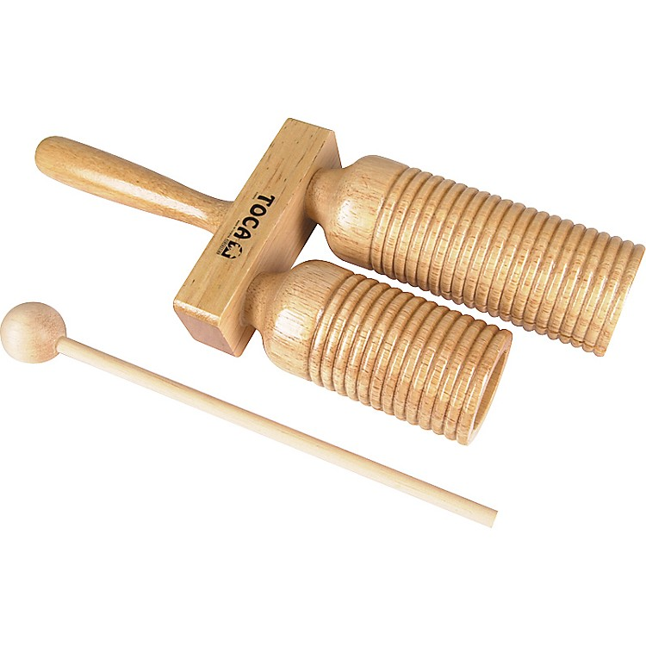
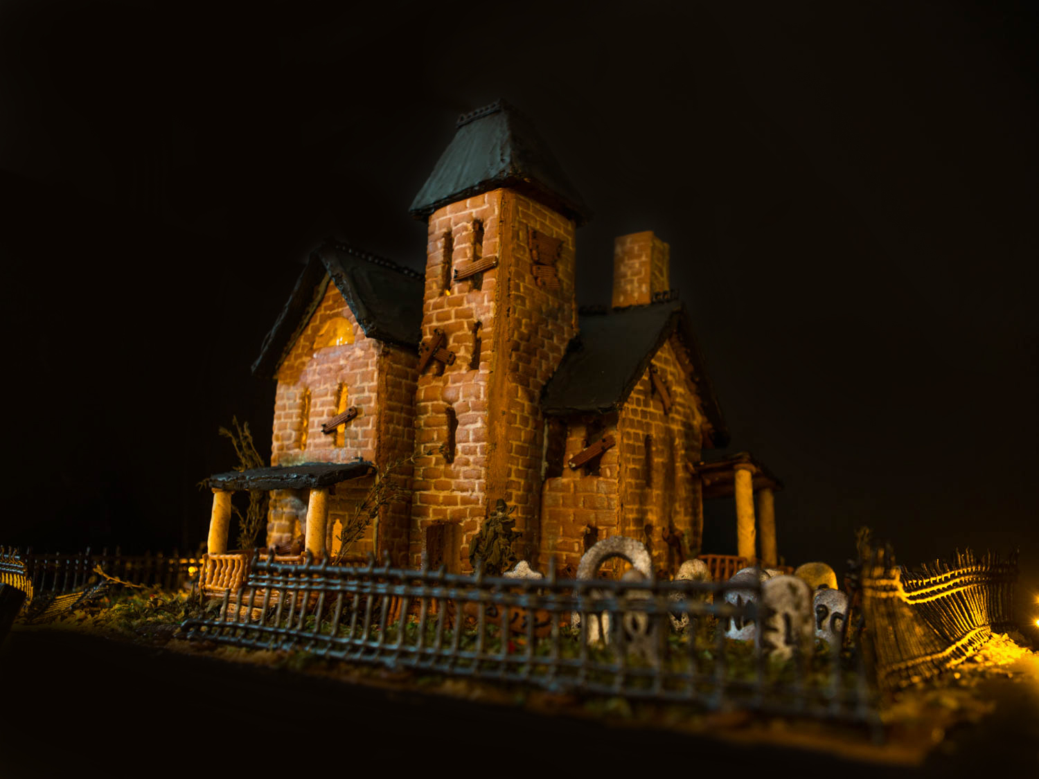

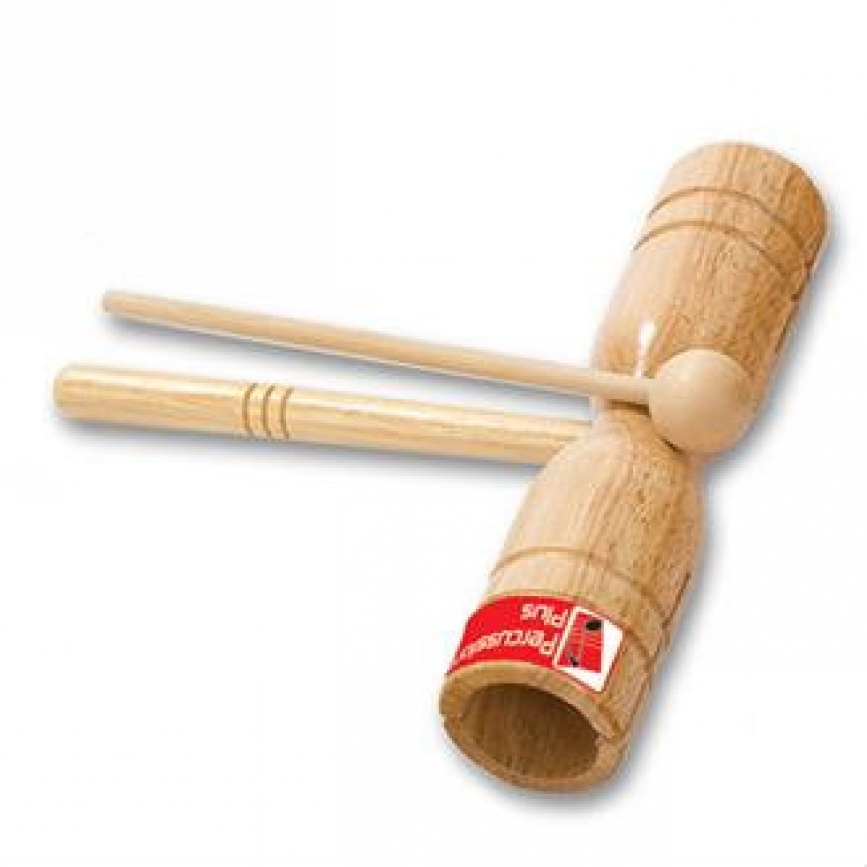

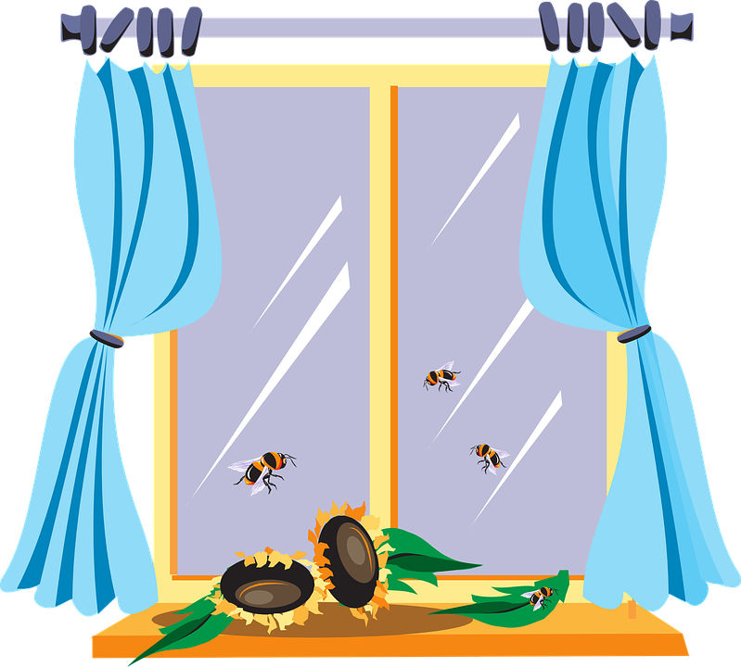




Back

Slide 26
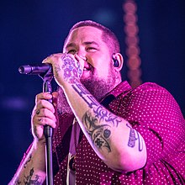
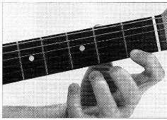
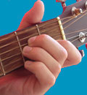
Pitch
Rhythm
Texture
(Am)
SOLO: Maybe I'm foolish, maybe I'm blind
(Am)
Thinking I can see through this and see what's behind
(Am)
Got no way to prove it so maybe I'm blind
1/1 1/1
But I'm only human after all, I'm only human after all
Am
Don't put your blame on me
Am
Don't put your blame on me
Am Am
Take a look in the mirror and what do you see
Am Am Am
Do you see it clearer or are you deceived - in what you believe
1/1 1/1
Cos I'm only human after all, you're only human after all
Am
Don't put the blame on me
Am
Don't put your blame on me
Melody
Tempo
Duration
Structure
Harmony
Silence
Dynamics
Timbre

Slide 27
Tuning Challenge 4

